Slide 1


Greater sales growth will result from changing our sales mix to include additional online store accounts.
Data-Driven Storytelling Presentation:
.

Slide 2

What we got from data
The best way to increase sales would be to put the freed-up sales and marketing resources into our online store accounts.
Closing a few extremely underperforming clients would free up resources for sales and marketing that could be used more profitably elsewhere.
Our sales performance has been decent overall, but it might be much better.
Our sales performance has been decent overall, but it might be much better.

Slide 3
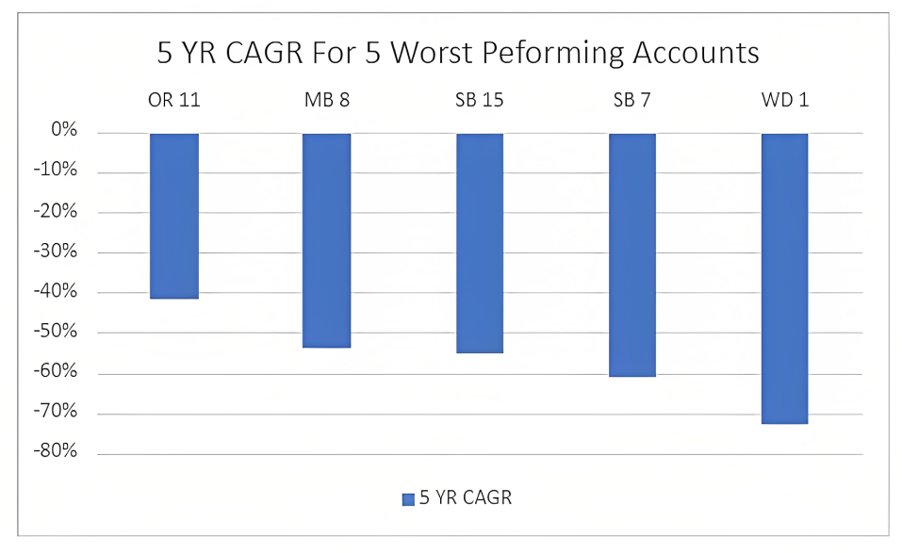
What we saw from data
The account OR11, MB8, SB15, SB7, WD1 are the worst performing account.
The above account want to take care and improve in next year.
It want to specially look these account and study the causes behind this made worst.

Slide 4
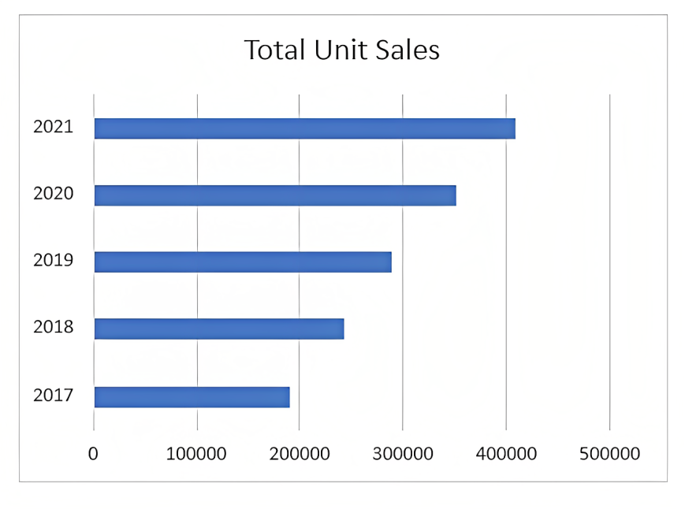
What we saw from data
With a 21% CAGR over the past five years, our unit sales growth has been strong overall.
It is good compared to last five years

Slide 5
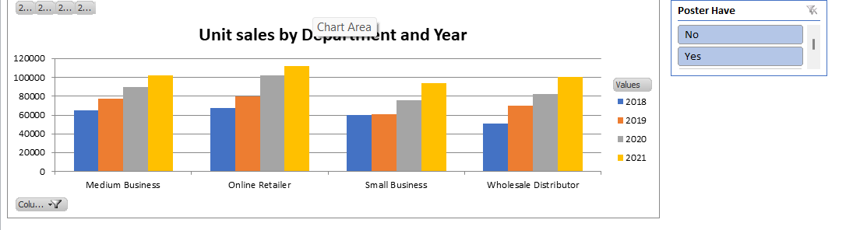
What we saw from data
More online retailer accounts in our sales mix and with our sales resources would result in higher sales growth.
Sale is increasing in each year

Slide 6
What we can conclude
We advise terminating these underperforming accounts right away and starting a search for the online store accounts with the greatest potential for increasing sales and marketing spend.
Although our sales performance has been strong generally, it might be much stronger.
Over the past five years, the type of online store account has had the strongest growth in sales.
Closing a few extremely underperforming clients would free up resources for sales and marketing that could be used more profitably elsewhere.
The best way to increase sales would be to put the freed-up sales and marketing resources into our online store accounts.

